Slide 1
At Ease
Jesse Parker
Mark Koren
Lucius Guthrie

Slide 2
The Problem
Communication between Tenants and Property Managers is sub par
Maintenance Requests go unnoticed
Rent Pay is a hassle
No peace of mind

Slide 3
Scope
Built for the Google Android Platform
Designed for small to medium sized Property Managers
Tenant accounts will be connected to their specific manager account

Slide 4
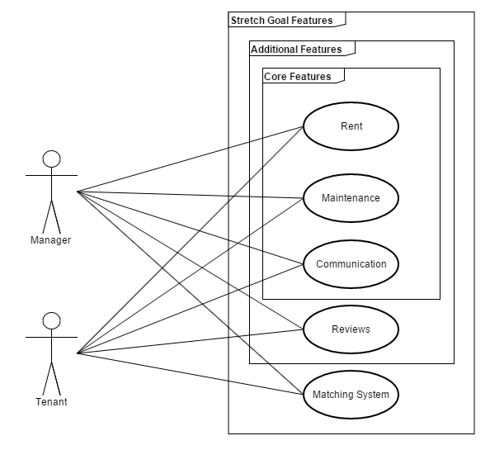
Overview
Two user accounts:
Manager
Tenant
Both have access to Rent Maintenance and Communication, although their features inside these areas will differ
Our optional Additional Features and Stretch Goal Features are shown

Slide 5
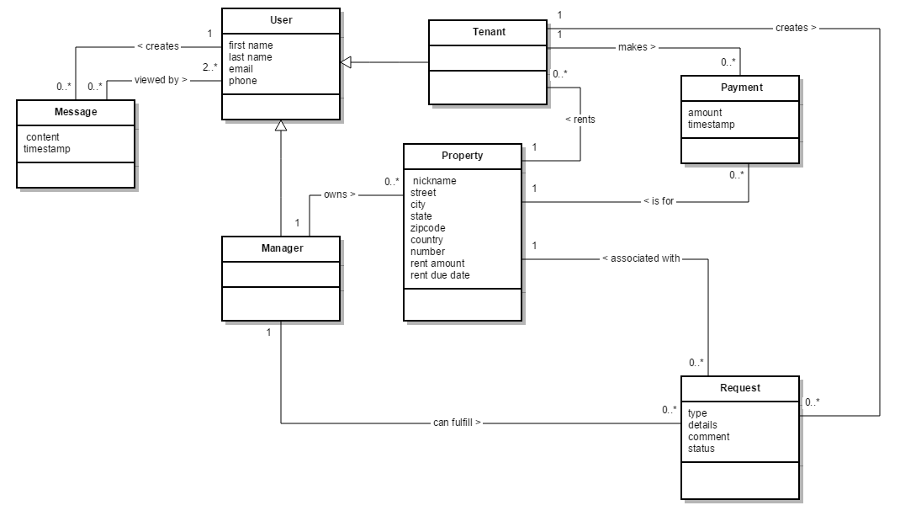
Overview - Class Diagram

Slide 6
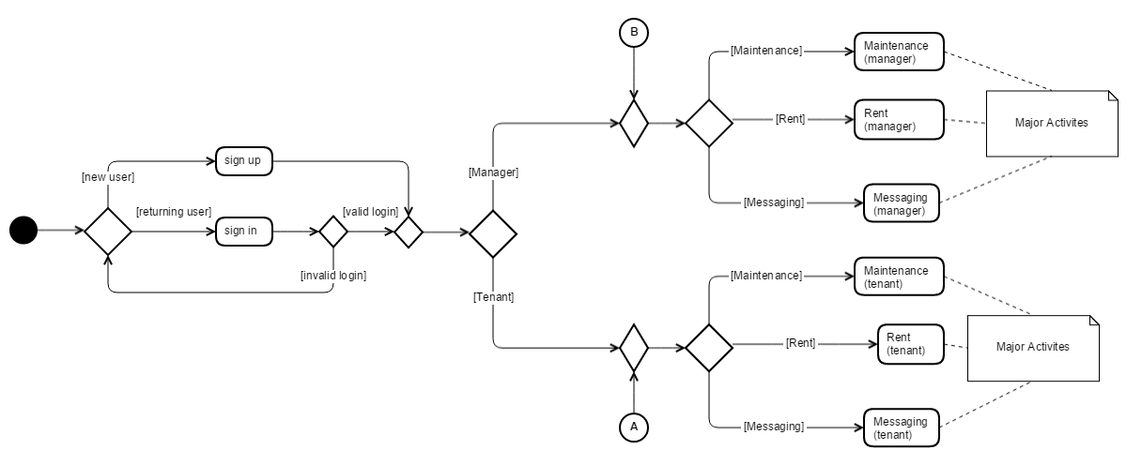
Overview - Activity Diagram

Slide 7
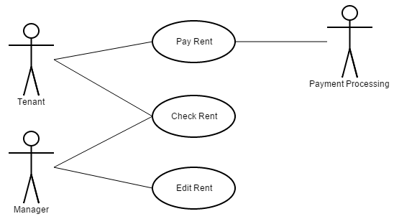
Rent - Use Case Diagram
Pay Rent
Tenants can pay rent through available payment processors
Check Rent
Tenants and managers can check due rent and payment history
Edit Rent
Managers can edit the amount of rent owed. For a lease term, rent should be locked.

Slide 8
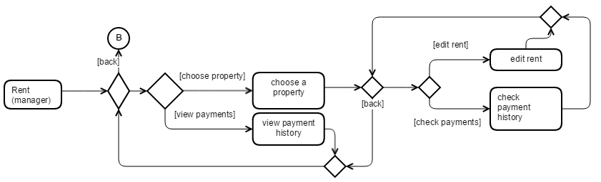
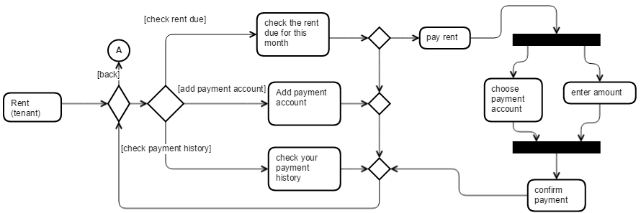
Rent - Activity Diagram
Simple rent management for managers.
Straightforward interface for Tenants
similar to paying for anything else online
Manager
Tenant

Slide 9
Rent - Functional Req’s
Requirement | Description | Priority
Set Rent | Allow the manager to set the rent for a tenant. This includes the collection frequency and dates. | Essential
Pay Rent | System for a tenant to pay the required rent to the manager. | Essential
Rent Reminders | User specified reminders for upcoming rent deadlines. A push notification would be good. Ideally, clicking the notification takes the user to the pay rent screen. | Medium
Request Rent | Managers can manually or automatically request late rent from a tenant. | Medium
Rent Penalty | Automatically assess a set penalty to late rent, if the option is enabled. | Low

Slide 10
Rent - Non-Functional Req’s
Requirement | Description | Priority
Financial Reliability | The payment system should be financially reliable, meaning that if there is a failure of some sort, no money is moved or lost. | Essential
Use Stripe | Integrate Stripe as a payment option. | Medium
Use PayPal | Integrate PayPal as a payment option. | High
Use Google Wallet | Integrate Google Wallet as a payment option. | Medium

Slide 11
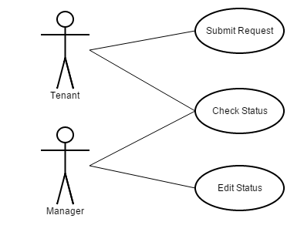
Maintenance - Use Case Diagram
Submit Request
Accessible by Tenant when maintenance request is needed
Check Status
Accessible by both Tenant and Manager
Edit Status
Accessible by Manager to make any necessary changes on the maintenance request status

Slide 12
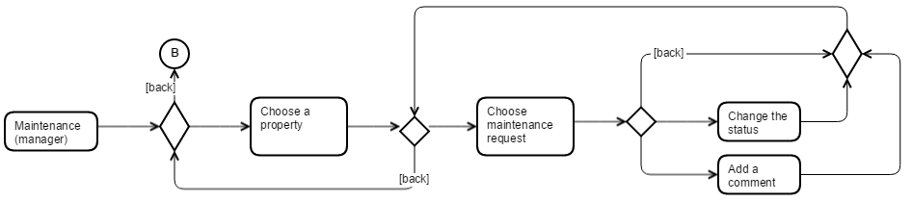
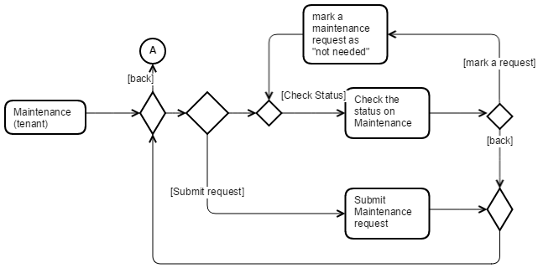
Maintenance - Activity Diagram
Interface allows manager to view and edit status of requests
Interface allows tenant to submit request and check status of previous request
Manager
Tenant

Slide 13
Maintenance - Functional Req’s
Requirement | Description | Priority
Initiate Maintenance Request | A tenant will create a maintenance request, which will be sent to the manager’s inbox. | Essential
Cancel Maintenance Request | Allow a tenant to cancel a previously issued maintenance request. | Essential
Close Maintenance Request | Allow a manager and tenant to jointly close a maintenance request. This function designates the request as resolved. | Essential
Update Maintenance Request Progress | The manager can update the status of the request, and post progress updates to keep the tenant informed. | Medium
Ask for Progress Update | Allow the tenant to request a progress update on a stale request. | Low
Attach Picture | Tenants can attach a picture to a maintenance request. | Low

Slide 14
Maintenance - Non-Functional Req’s
Requirement | Description | Priority
Use Parse | Store data in Parse. | Essential
Maintenance Request Form | Have a set form for tenants to enter data into to create a maintenance request. | Essential
Customizable Form | Allow managers to create their own custom maintenance request form. | Stretch
Store Pictures | Have a storage system for the pictures uploaded with maintenance requests. | Low

Slide 15
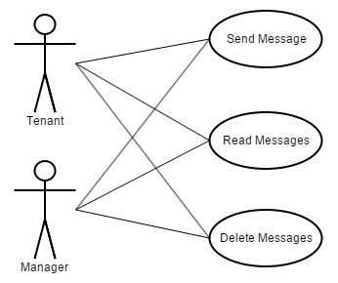
Communication - Use Case Diagram
Send Message
Allows both Managers and Tenants to send messages to certain groups
Read Messages
Allows both Managers and Tenants to read received messages
Delete Messages
Allows both Managers and Tenants to delete received messages

Slide 16
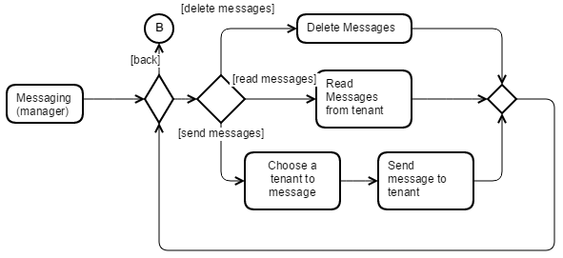
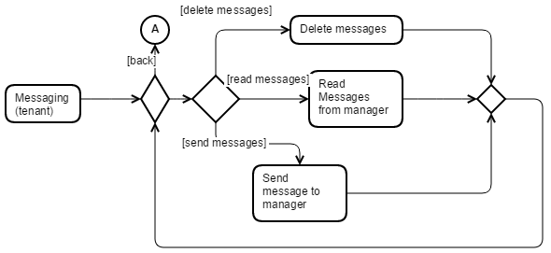
Communication - Activity Diagram
Similar process for both tenant and manager
Different messaging options would lead to more paths, but the same loop
Manager
Tenant

Slide 17
Communication - Functional Req’s
Requirement | Description | Priority
Manager->Tenant direct message | A direct message from the manager to the tenant. | Essential
Tenant -> Manager direct message | A direct message from the tenant to the manager. | Essential
Manager -> Room group message | A group message from the manager to a room. | Medium
Manager-> Building group message | A group message from the manager to a building. | Medium
Building bulletin board | A place where users can place messages and announcements visible to the whole floor, building, complex, or system. Ads here would be useful as well. | Stretch
Tenant -> Room “door note” | A system for tenants to leave anonymous messages visible to everyone in a room. The manager will have access to see who posted the message, to prevent abuse. | Stretch

Slide 18
Communication - Non-Functional Req’s
Requirement | Description | Priority
Use Parse/Sinch | Use a combination of Parse and Sinch to store and send messages securely. | Essential
Use Parse Users | Control user access using the Parse User feature. | Essential
Bulletin Board Recyclerview | Use a recyclerview to show the Bulletin Board, and design the layout to look like a physical one. | Low
Door Note Graphics | Design the graphics of the door note system to actually look like a whiteboard on a door. | Low
Load Inbox Dynamically | When loading the inbox, dynamically show messages as they load. | Medium
100+ Item Storage in Inbox | Keep up to 100 items in an inbox of a user. | High

Slide 19
Reviews - Functional Req’s
Requirement | Description | Priority
User Profiles | A profile page for managers and tenants. Could include contact info, a description, and various other common social media profile components. | Stretch
Building Pages | A page for a building. It should include a description, pictures, | Stretch
Tenant Reviews | Reviews of a tenant, covering their rent reliability and how easy they are to rent to. | Stretch
Manager Reviews | Manager reviews, covering how easy they are to rent from. | Stretch
Building Reviews | Building reviews, covering quality, features, and livability. | Stretch
Building Amenities | A list of amenities available at the building. | Stretch

Slide 20
Reviews - Non-Functional Req’s
Requirement | Description | Priority
Compute an Average Rating | Compute an average rating from all the ratings given to a user or place. | Stretch

Slide 21
Matching System - Functional Req’s
Requirement | Description | Priority
Searchable Buildings | Allow users to search the database of buildings by name, location, or amenities available. | Stretch
Roommate Match | Match tenants to other tenants who would be compatible roommates, based on a survey. | Stretch
Manager Match | Match tenants to a nearby manager or building, based on a survey. | Stretch

Slide 22
Matching System - Non-Functional Req’s
Requirement | Description | Priority
Advanced Search Menu | Have a standard, easy to use form to allow advanced searching of users and buildings. | Stretch

Slide 23
Features
Required
Maintenance Requests
Rent Pay
Messaging
Possible
Manager Reviews
Maintenance Account
If Time
Building Profile
Matching System

Slide 24
Risks
Not able to learn all of the technologies we plan to use
Possibly too large of a project for the time frame
Setting expectations too high for specific features

Slide 25
Summary
Features address main problems
Flexibility of requirements reduces the risk of time overruns
Use of third-party services allows for faster implementation

